Slide 1




GPP 3PL Cold Storage Opportunity
Direct runway access at an Airport on the East Coast of the USA with great access to all airports and internationally
Great Access to most cities domestically
In a Foreign Trade Zone
Customs/TSA clearance on site

Slide 2
INNOVATIVE SOLUTIONS FOR YOUR BIGGEST INVESTMENT
With increasing demands in an ever-evolving regulatory landscape, the life science and pharmaceutical industry is facing a new set of challenges and emerging supply chain issues. GPP 3PL Solutions sits at the forefront of logistics innovation featuring:
Direct runway access at a major international airport
State of the art cGMP facility scalable to over 2 million square feet
Best in class monitoring software and warehouse inventory technologies
In a Foreign Trade Zone
Minutes to several ocean ports
Leveraging unrivaled proximity to the ocean ports and other airports. GPP 3PL offers fewer touch points, eliminates costs, time and risk, and boasts an impressive “24-hour turnaround time” from receipt of an order to dispatch.
This all comes together to ensure optimal product integrity throughout every step of the supply chain, superior quality assurance, and most of all, peace of mind.

Slide 3

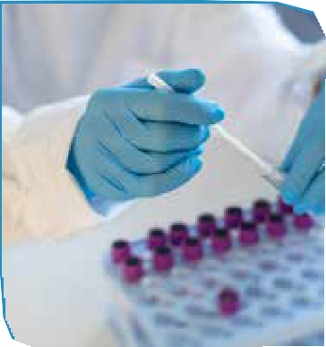

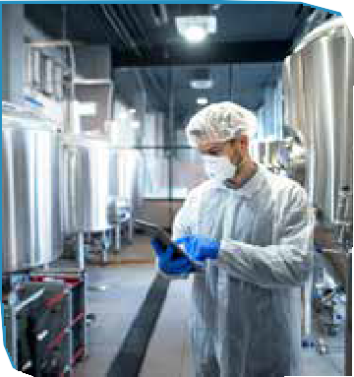

805 DEPOT
60,000 Sq Ft cGMP Facility (Operational)
5 Minutes from key airport
12 Minutes from key Port on the ocean
Airport DEPOT 1
500k Sq Ft cGMP Facility Delivering Q1 2024
At Key International Airport
15 Minutes to key Port

Slide 4
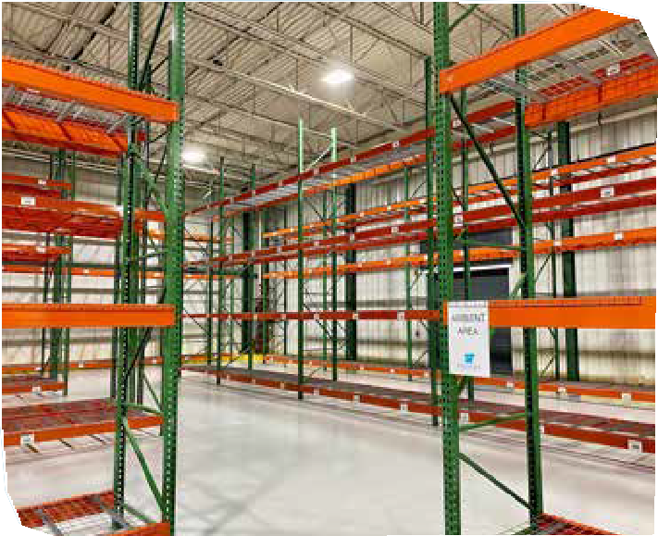
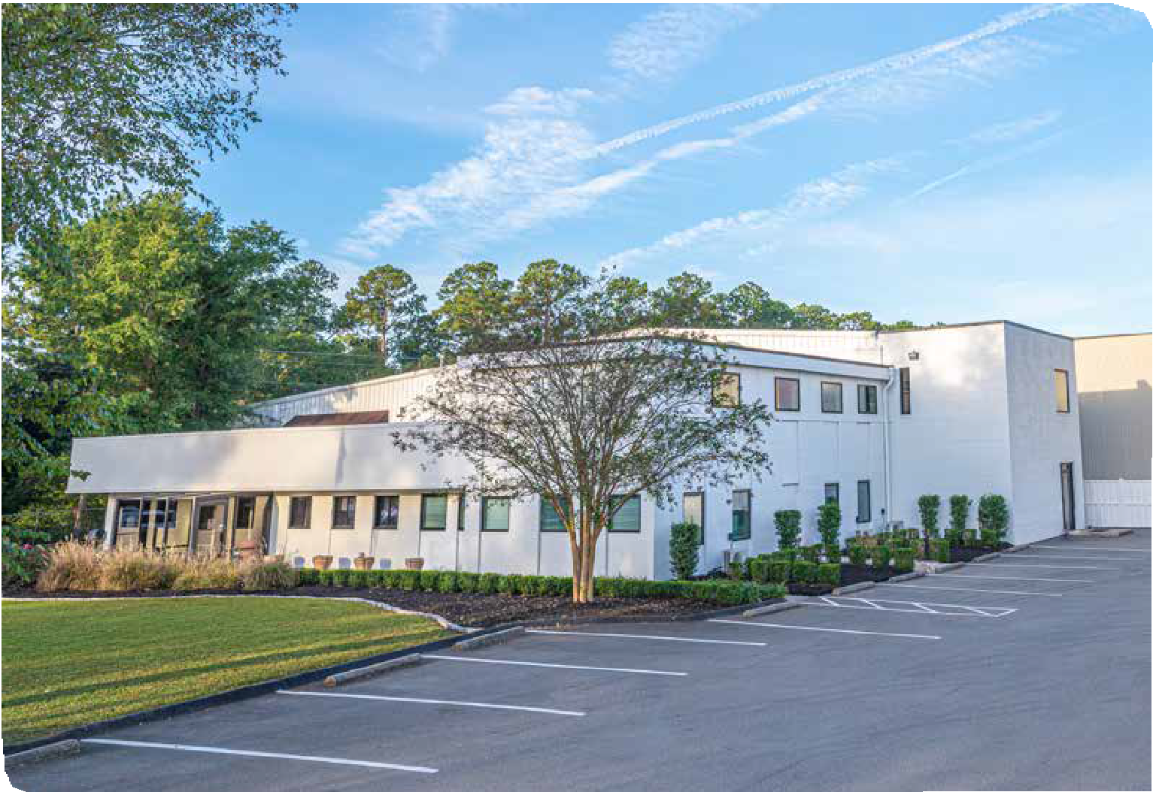
GPP 3PL 805 DEPOT
FACILITY HIGHLIGHTS
60,000 Sq Ft cGMP Facility (Operational)
Controlled Room Temperature/ CRT (5,000+/- pallets)
2° to 8°C (300+/- pallets)
-20° to -86°C Ultra-Cold Capabilities (25+ Freezers)

Slide 5
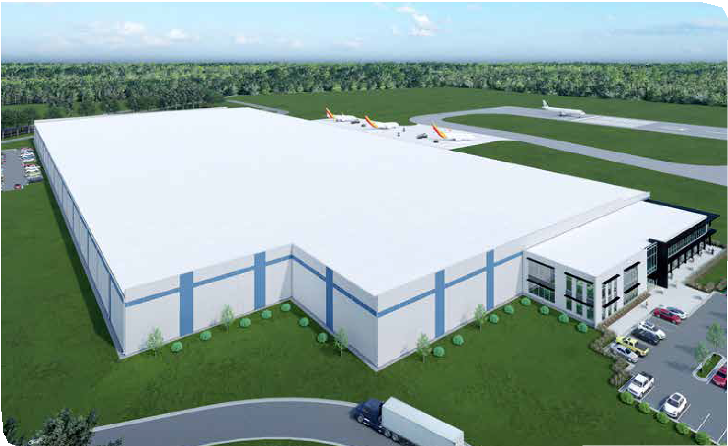
GPP 3PL DEPOT
1 FACILITY HIGHLIGHTS
500k Sq Ft cGMP Facility Under Construction Delivering Q1 2024
Controlled Room Temperature/ CRT (12,000+/- pallets)
2° to 8°C (44,000+/- pallets)
-20° to -30°C (4,000+/- pallets)
-70°C Ultra-Cold Walk-in Chambers (21,000 ft3)
-86°C Ultra-Cold Capabilities
7

Slide 6




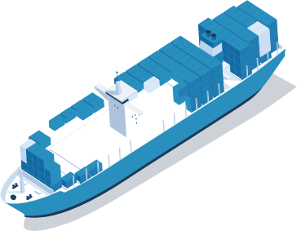


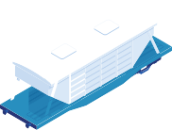



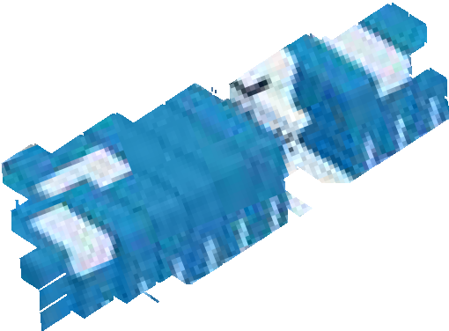
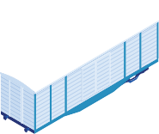







ON THE FRONT LINE OF SUPPLY CHAIN TECHNOLOGY
GPP 3PL Solutions is committed to supporting mission-critical life science initiatives by offering best-in-class cGMP temperature-controlled storage, distribution, and end-to-end logistics services.
As a highly accredited industry-partner, GPP 3PL Solutions employs an innovative approach to the most stringent FDA and cGMP-compliant logistics management practices to help solve today’s most prevalent distribution issues. Our mission is to ensure optimal product integrity throughout the pharmaceutical supply chain, so life sciences companies can focus on developing the next life-changing breakthroughs.

Slide 7


QUALITY ASSURANCE
From state-of-the art cold storage facilities to the latest in cutting-edge technology, GPP 3PL Solutions utilizes an innovative approach that exceeds cGMP and FDA standards to give you peace of mind through every step of the supply chain.
STORAGE
GPP 3PL Solutions is the only 3PL with ultra-cold walk-in chambers delivering comprehensive, end-to-end cold storage solutions that utilize cutting-edge monitoring and control technology to safely store and deliver products with greater speed and precision.
SOFTWARE
Our advanced cloud-based Warehouse Inventory
Management System provides real-time insights into product location within GPP 3PL Facilities. State-of-the-art temperature reporting & recording allows for unique client visibility plus the latest Building Management Software offers predictive monitoring of environmental control systems.
SERVICES & SOLUTIONS
Our state-of-the-art facility and dedicated team become an extension of your hard work and investments. With services like dedicated customer support, shipping management and integrated inventory management, plus located on runway at an International Airport in a Foreign Trade Zone and custom clearance, you get more then just a cold storage solution.
DISTRIBUTION
With direct runway access to an International Airport and strategically located mere miles from a major seaport, GPP 3PL Solutions provides multi-modal connectivity saving time and money.
OUR EXPERTISE

Slide 8



UNPARALLELED MULTI- MODAL CONNECTIVITY
Highlighted by an exclusive agreement with the International Airport, great proximity to the seaport
and in the city’s Foreign Trade Zone, GPP 3PL Solutions delivers valuable and simplified connectivity to offer quicker, more efficient, risk-averse service, with fewer touchpoints.
Uniquely positioned at the International Airport with direct runway access
Located in a Foreign Trade Zone with Customs and Border Protection on site for efficient processing
Exclusive Agreement with the International Airport for Depots for cGMP Certified Logistics, Distribution and/or Storage of Pharmaceuticals
Easy Access to two highways;
Less than a 15-minute drive to the Seaport

Slide 9


AN INNOVATIVE APPROACH
TO ADVANCING COLD STORAGE
Our partner delivers comprehensive, end- to-end cold storage solutions that utilize cutting edge monitoring and control technology to safely store and deliver products with greater speed and precision.
With a rich history of building and operating several million square feet of best-in-class, cGMP temperature-controlled storage facilities across the globe, the GPP 3PL Solutions team is armed with decades of intimate knowledge into regulatory practices and the industry-leading cold storage, logistics, secondary packaging and kitting/ labeling processes and reverse distribution.

Slide 10





COLD STORAGE
Ultra-cold Latest Energy walk-in chambers Efficient Technology
Controlled Ambient
24/7/365 BMS
Connectivity to
Sampling
Monitoring BMS/3rd-Party Monitoring
PROFESSIONAL SERVICES
Advanced Dedicated Integrated Inventory Reporting Platform Customer Support Management
Shipping Management
Innovative Shipping Kitting, Labeling &
Notification System Secondary Packaging
DISTRIBUTION ADVANTAGES
In Foreign
Trade Zone
Customs & Border Protection Logistics
Direct Runway Access at airport
TSA Screening
Temperature Controlled Distribution to Port
Reverse Distribution

Slide 11

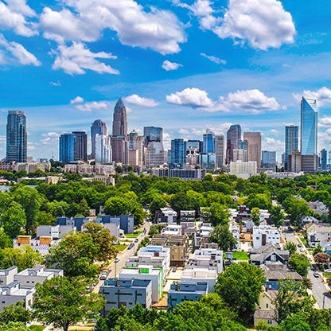
INVESTING IN INNOVATION
The business-friendly city enjoys the lowest corporate many benefits as compared to others in the nation and has quickly ascended into a burgeoning hub for a host of dynamic industries filled with startups and Fortune 500 companies.
Our partner is also conveniently located just over two hours from a major seaport city

Slide 12
#1
$200M
Seaport City which has invested $200 million in infrastructure and increased refrigerator capacity by 3x
Seaport City is experiencing rapid growth, ranking the #1 city that people relocated
to in 2022 and placed in the top 10 for three consecutive years
State is ranked No. 1 in the U.S. for lowest state and local tax burden with a very low corporate tax rate
600+
More than 600 life science companies in the state
$6.4B
#3
$6.4B total biomanufacturing investments local cities since 2018
Local Cities top the U.S. market list claiming home to
3 of Top 30 NIH-funded institutions

Slide 13
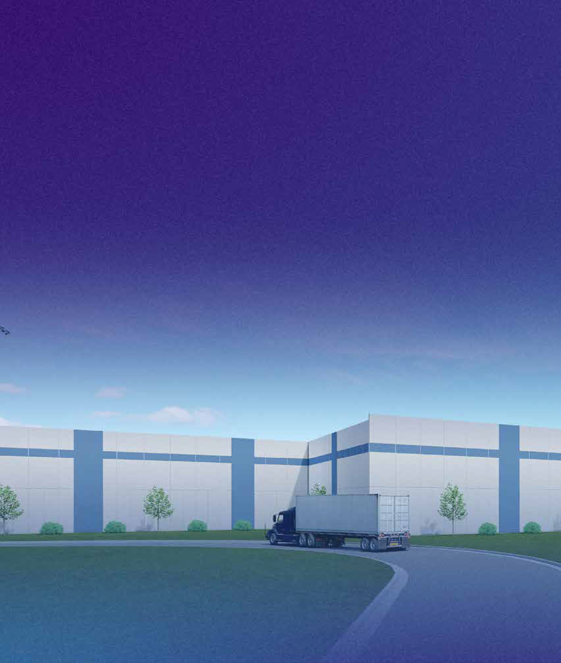
FORGING A NEW PATH
Our partner is committed to supporting mission-critical life science initiatives by offering
best-in-class cGMP temperature-controlled storage, distribution, and end-to-end logistics services.
Our mission is to ensure optimal product integrity throughout the pharmaceutical supply chain, so life sciences companies can keep focus on developing the next life-changing breakthrough.

Slide 14



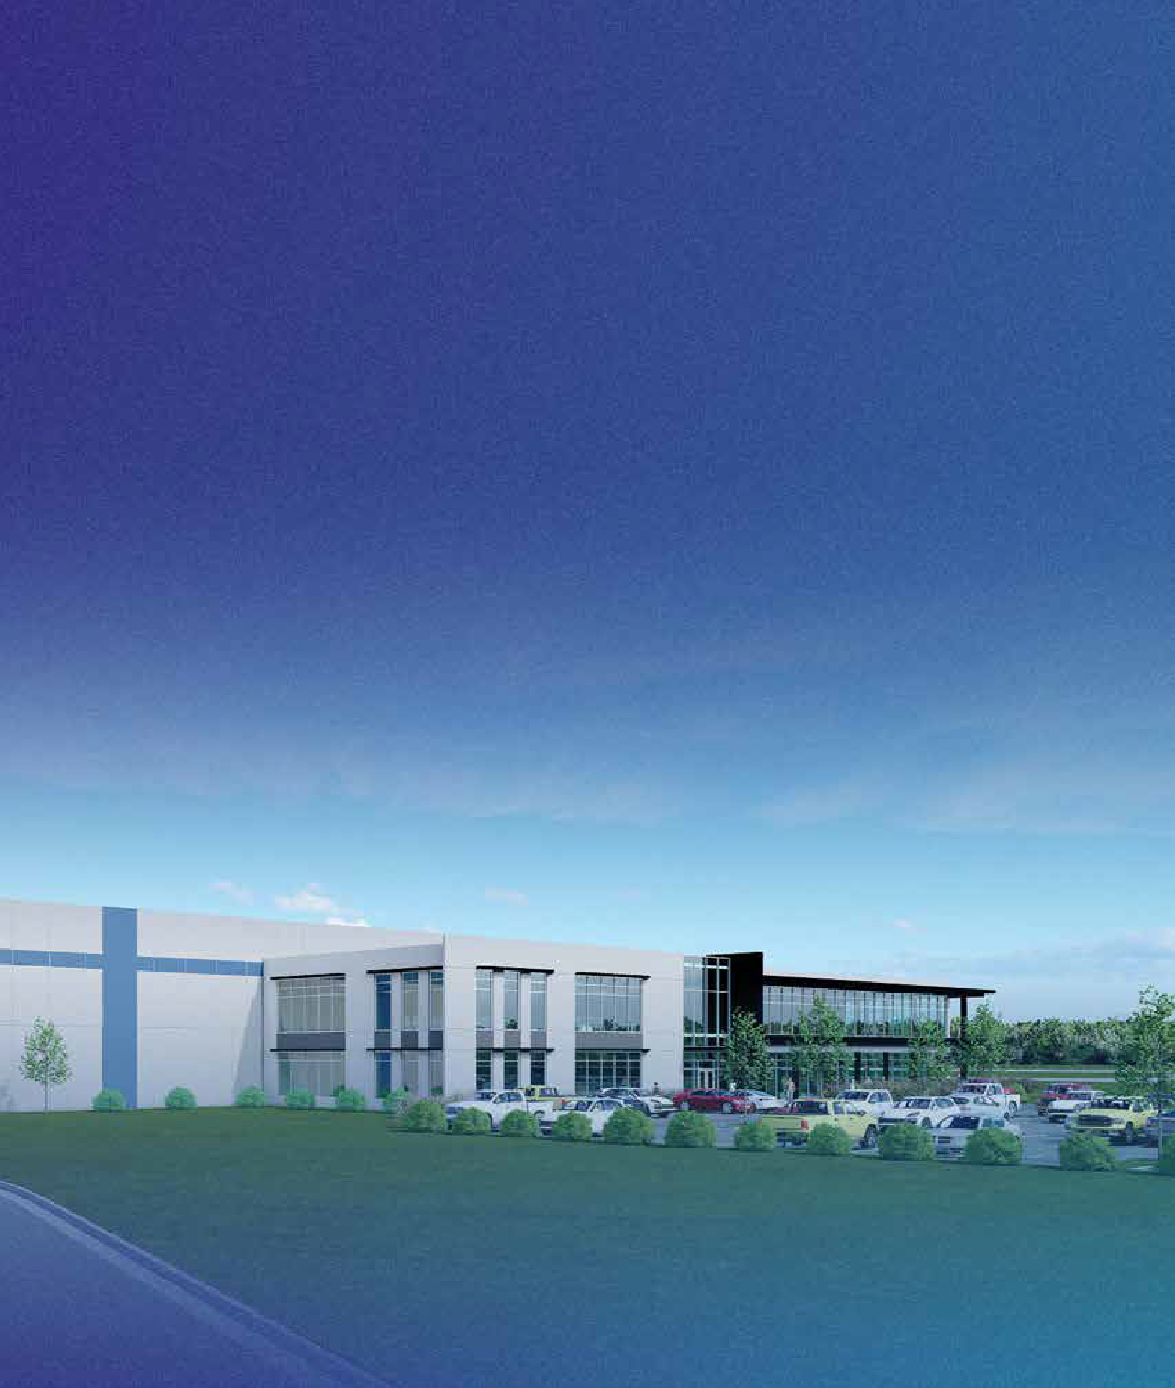
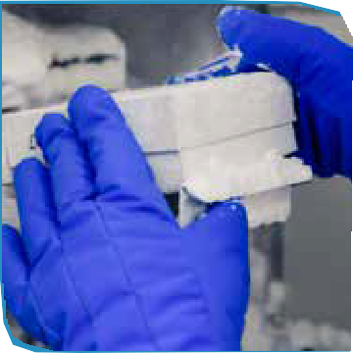
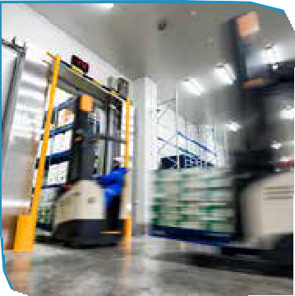

GPP 3PL SOLUTIONS

Slide 15



Rob Camerer
+1 417-440-4600
robcamerer@globalpharmapartners.com
Joseph Corsetti
+1 201-919-2047
jcorsetti@globalpharmapartners.com

